Slide 1
SALES FORECASTING
GURUPRASARH K
DA/DS TRAINEE

Slide 2
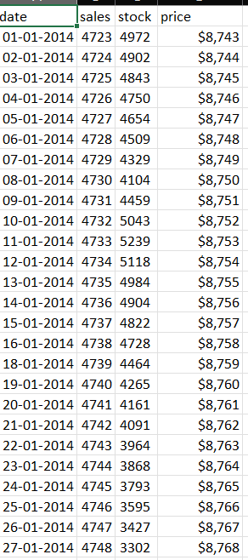
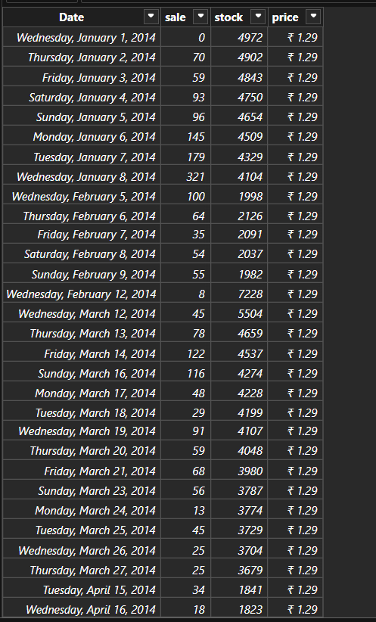
DATA CLEANING & TRANSFORMING
DATASET
DATA TRANSFORM

Slide 3
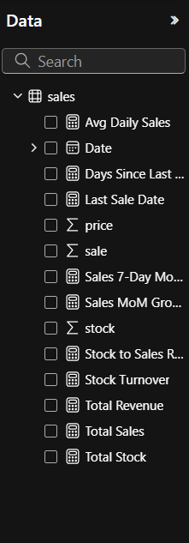
DAX FUNCTIONS

Slide 4
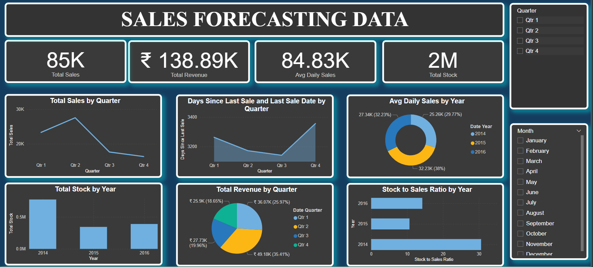
DASHBOARD

Slide 5
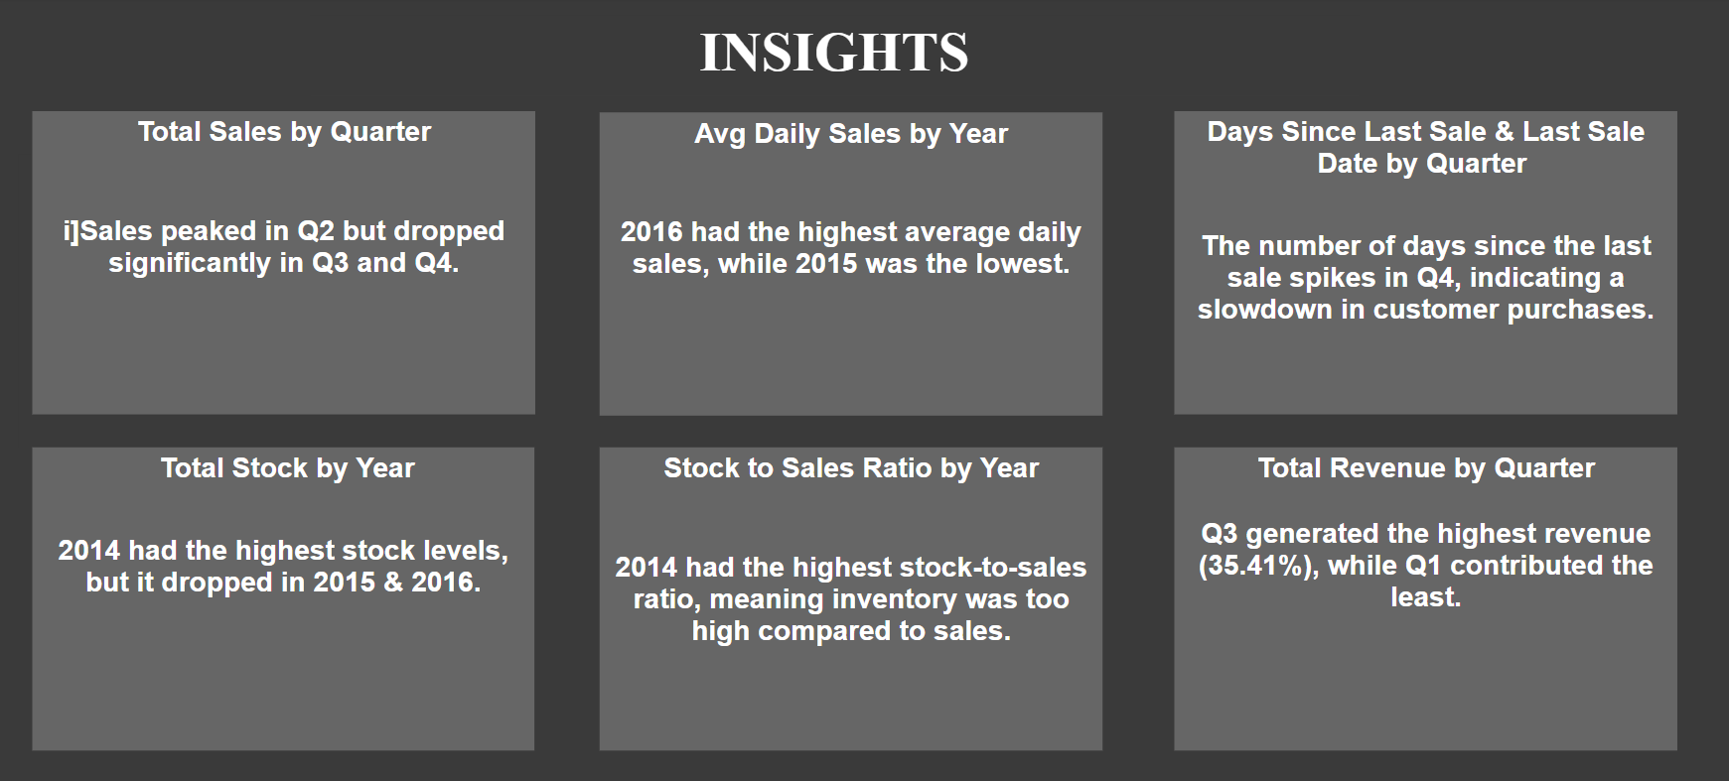

Slide 6
THANK YOU

